Slide 1
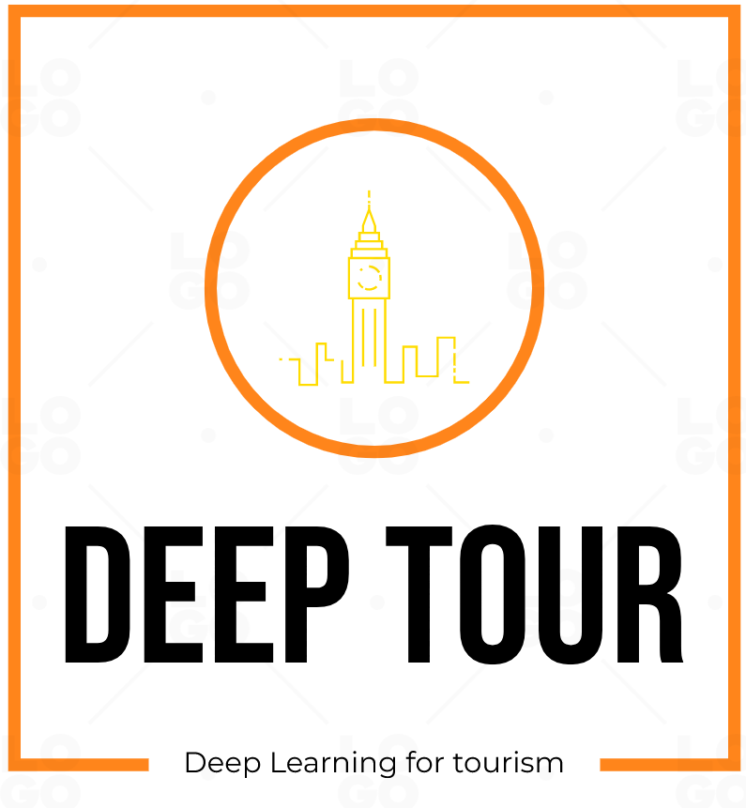
By Team 2: Yohan LANG, Norman DORET, Andrei PALAEV

Slide 2
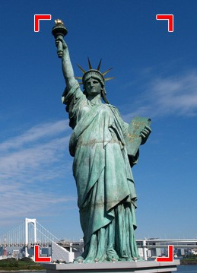
Problem statement
Given the phone’s camera feed, detect all the monuments and interest points while providing information about them

Slide 3
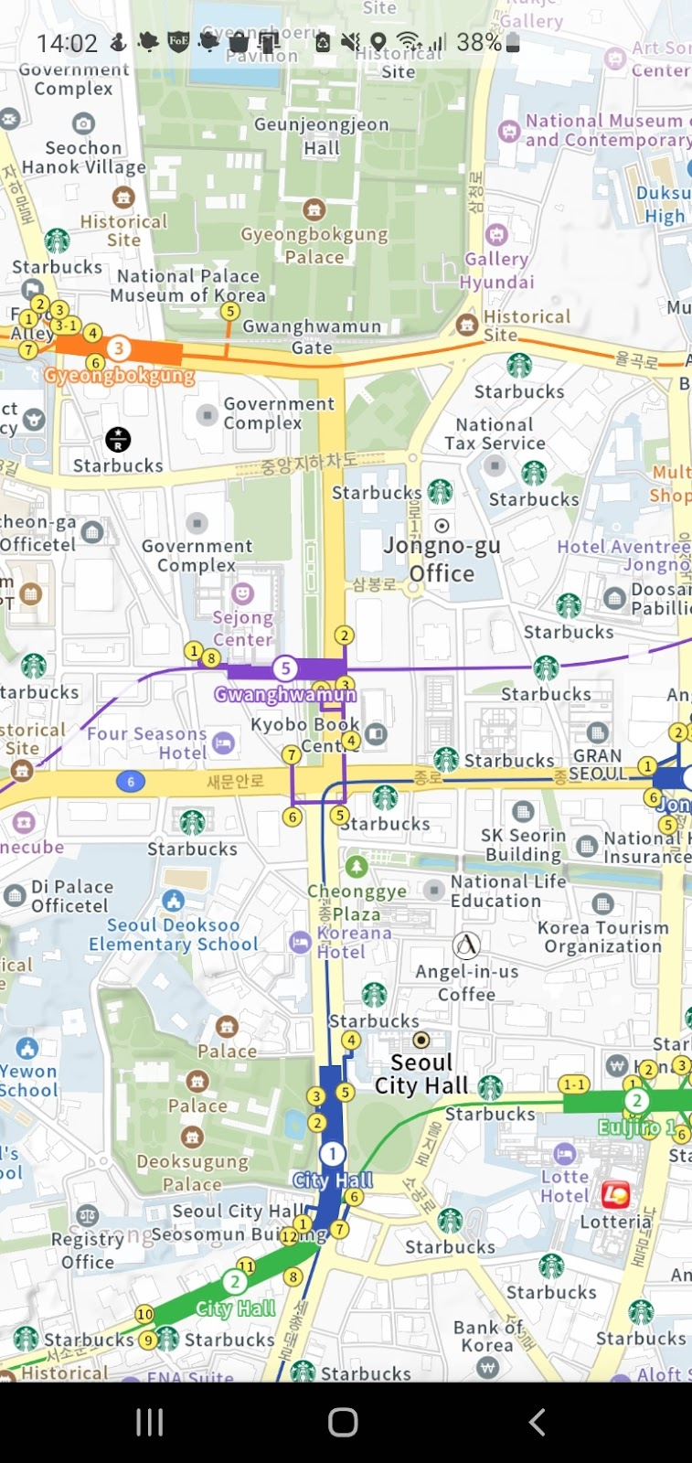
Target users
Really difficult to retrieve information about the monument you are in from location apps
Foreigners unable to speak the local language
Tourists or new residents discovering the city by themselves
Curious bypassers and culture enthusiasts
What is the name of this monument I’m seeing right now ?
Who created it ?
How can I learn more about it ?
I don’t have time to pinpoint each building on the map, I'm just passing by
Maybe a real time solution of monument recognition?

Slide 4

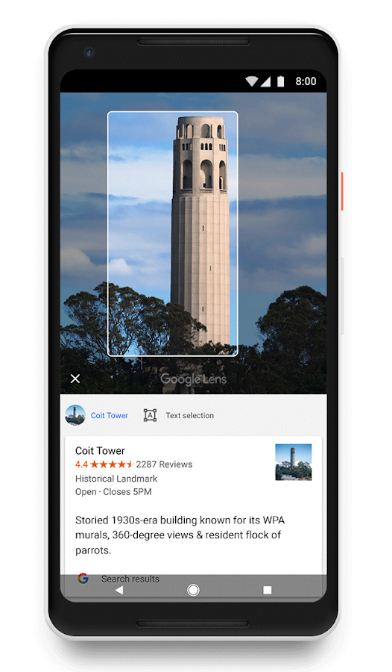
Existing solutions
Google Lens
Heavily relies on server-side processing
Has big problems with privacy
Does not process live feed

Slide 5
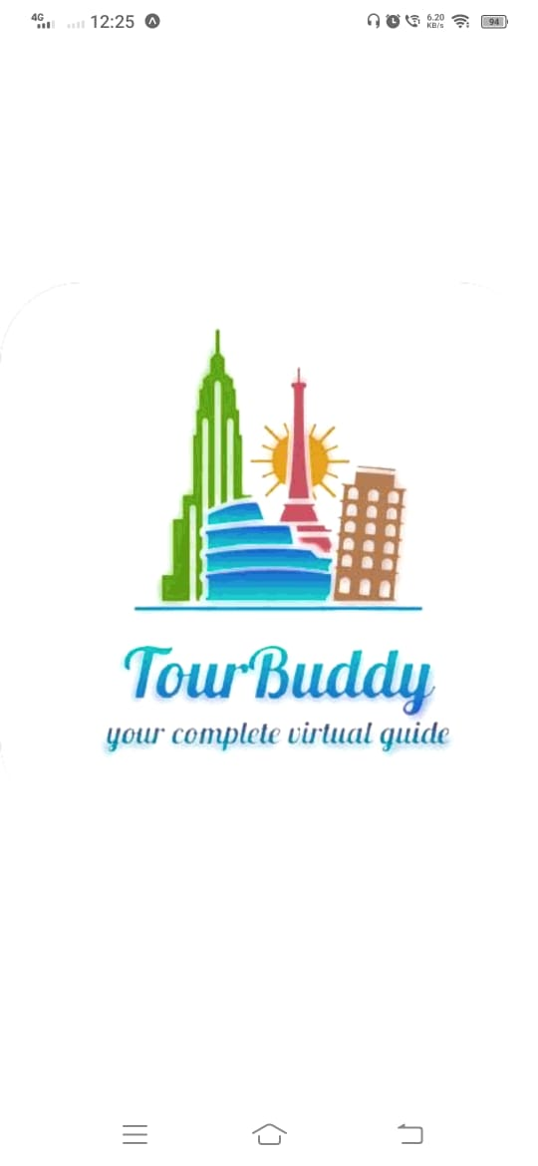
Existing solutions
There are also some researches about monument detection apps
Process already taken photos, not the camera image itself
Mainly used for ulterior classification (album creation)
Notes:
https://stacks.stanford.edu/file/druid:bf950qp8995/Timmaraju_Chatterjee.pdf
https://www.researchgate.net/publication/330766821_TOWARDS_DEEP_LEARNING_FOR_ARCHITECTURE_A_MONUMENT_RECOGNITION_MOBILE_APP

Slide 6

Key solution
By providing an augmented experience for something as simple as a walk, we make city touring accessible to any person with a smartphone.
Represent an earn of time to those who want to visit and learn about a city by looking the surrounding.
Deep Tour provides a deep learning solution to those questions, right in your pocket.

Slide 7
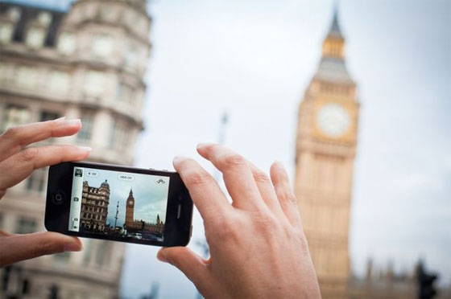
Usage scenario
Big Ben
Design: Augustus Pugin
Completion: 1859
Height: 96 meters
URL: https://en.wikipedia.org/…
Map: https://www.google.com/maps/…

Slide 8

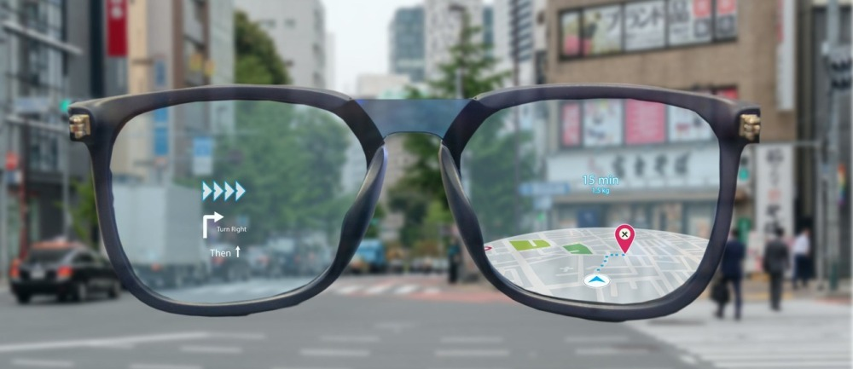
Optional features and extensions
Notification system for nearby interest points
Recommendation system
Screen and audio guidance (“look right to see the Westminster palace”)
Google glasses extension
“You are passing by Big Ben”
Big Ben
Design: Augustus Pugin
Completion: 1859
Height: 96 meters URL: https://en.wikipedia.org/…
Map: https://www.google.com/maps/…

Slide 9
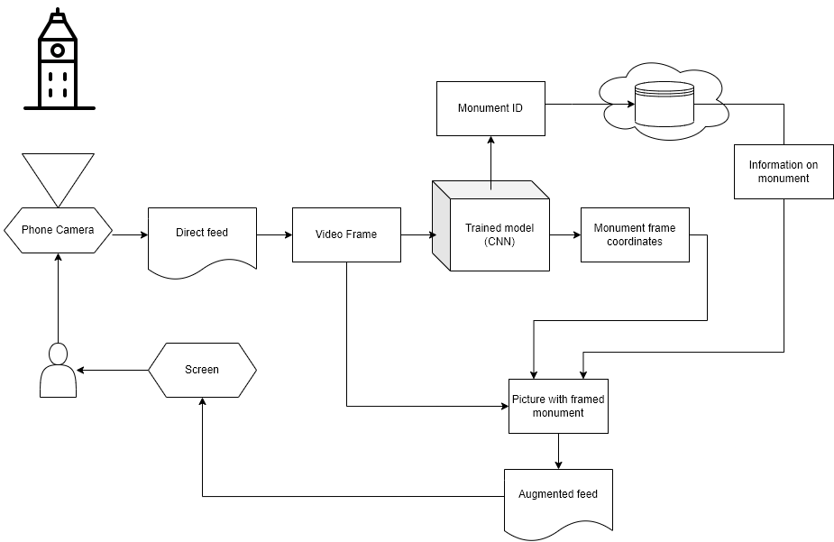
System overview

Slide 10
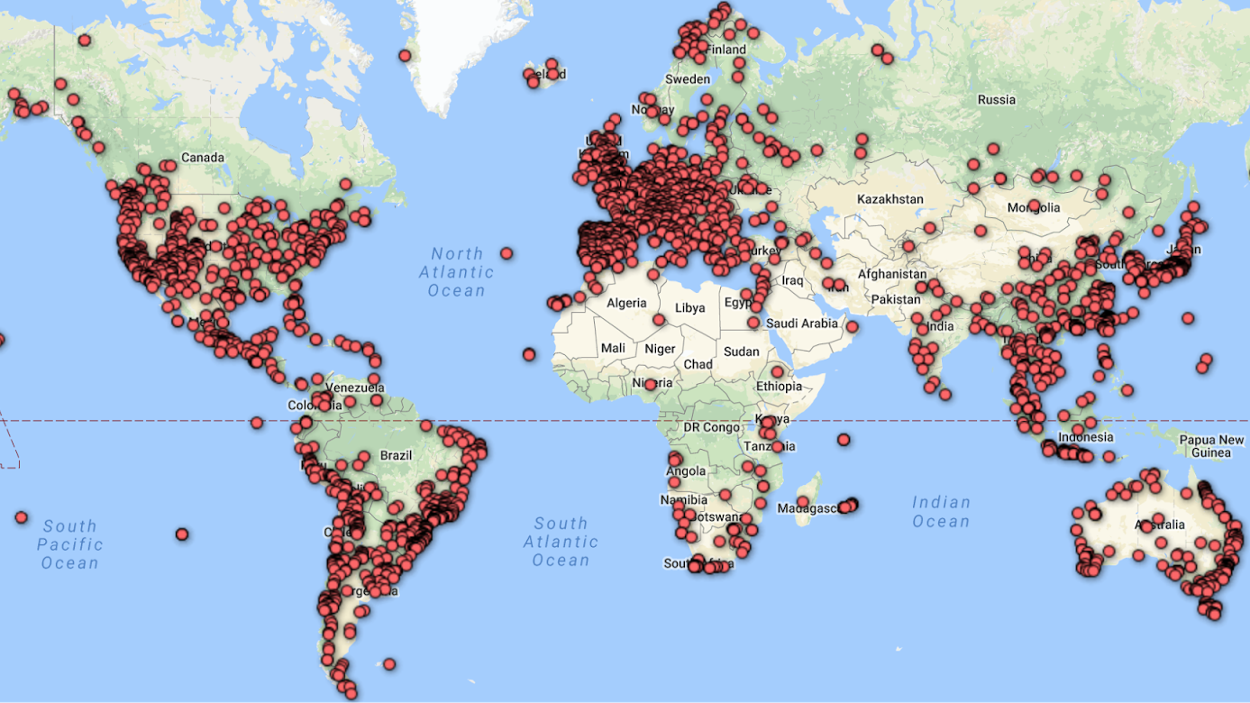
Challenges and solution ideas
Find the training dataset
Google Landmarks dataset is a wide dataset which contains monuments images and corresponding bounding boxes
Notes:
https://www.kaggle.com/datasets/google/google-landmarks-dataset
https://www.kaggle.com/c/landmark-recognition-challenge/overview

Slide 11
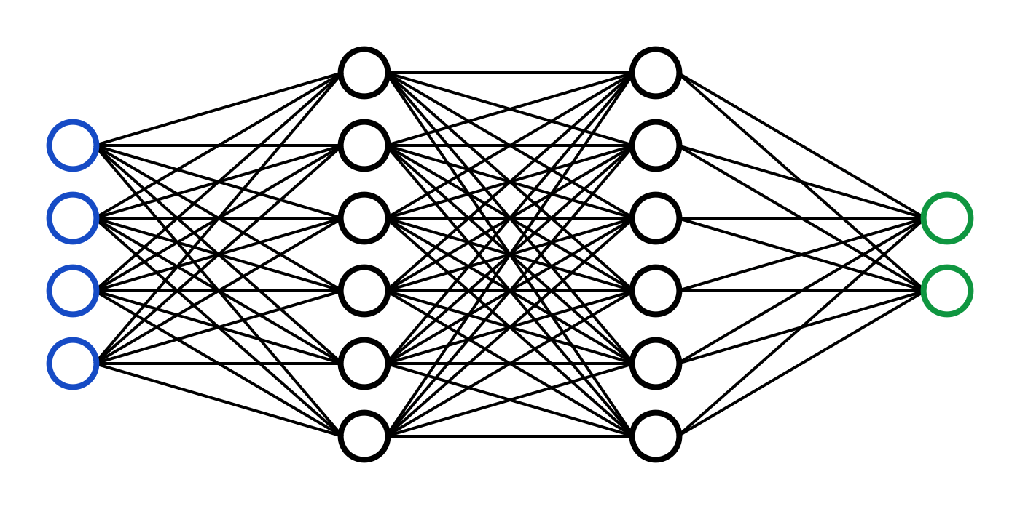
Challenges and solution ideas
Training a Neural Network for monuments detection
There exist some pretrained models for object detection
Neural Network can learn embeddings instead of labels

Slide 12


Challenges and solutions ideas
Interactivity and reactivity:
Augmented reality rather than just image processing
Extract frames from the camera feed
Using the same method as a snapchat filter
Running a deep learning model on smartphone
Light and fast trained model
TensorFlow Lite or Pytorch Mobile is the solution

Slide 13

Evaluation Strategy
User study with a real condition simulation in Seoul
Search the limits of the recognition algorithm
Give access to the app to a trial sample (acquaintances) and collect feedback
Is it easy to use on the streets ?
Does it return enough information ?
Notes:
Collect users' feedback about the quality of the system, UI, …
Search the limit of the recognition algorithm
Give access to the app at some acquaintances which could represent our sample
Is it easy to use in the street?
Does it return enough information?

Slide 14
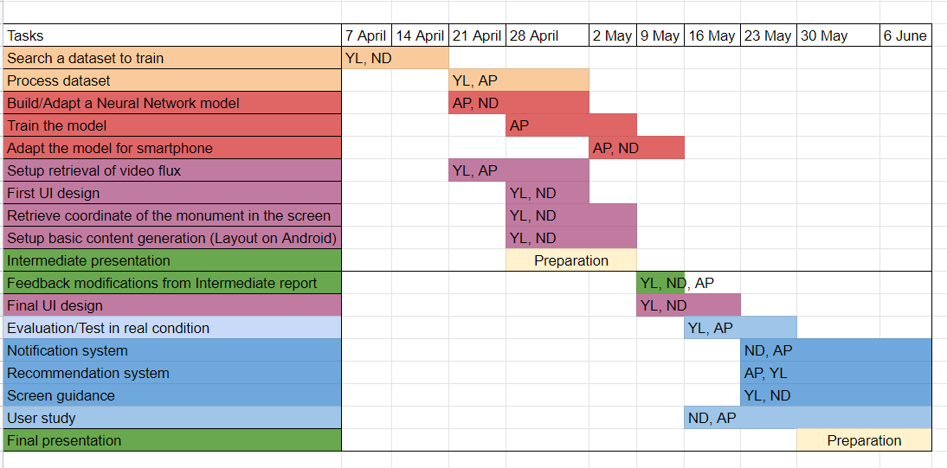
Project Plan
Project plan

Slide 15

Final deliverable
Success criteria
An Android application that:
Takes the image from the phone camera
Shows the results of the monument detection and provides the information about them
The app detects the monuments with high accuracy
The app gives the relevant information about the monuments

Slide 16

Thank you for your attention !
Do you have any questions ?

